Slide 1


PlanIT
Honey Turtle
Darren Gan
Loh Yu Jin
Michelle Lion

Slide 2
Customer Segment
Retail customers in their early career seeking to better manage their finances
Area of Concerns
Lack of Know-How
Personalised Financial Planner
Easy to Use
Highly Integrated with all their Banking Activities
Decision Making in Banking Products

Slide 3
Problem Statement #1
With limited knowledge and experience, the youth, millennials and their parents face multiple challenges in financial planning and management.
Our Solution
All in One Dashboard
Real-time Recommendation
User Profiling
Allow easy financial planning usage
Control over finances
Suggest ways to increase financial literacy
Personalised recommendation to ensure useful marketing efforts
Ensure users of all demographics can be accommodated
Allow for customisable interface

Slide 4
Disrupt Bank by:
We
Faster Time-To-Market
Become a “Utility”
Leveraging on Open API services
Benefit Customer by:
Omnichannel Banking
Customised Recommendation
Better Financial Control

Slide 5
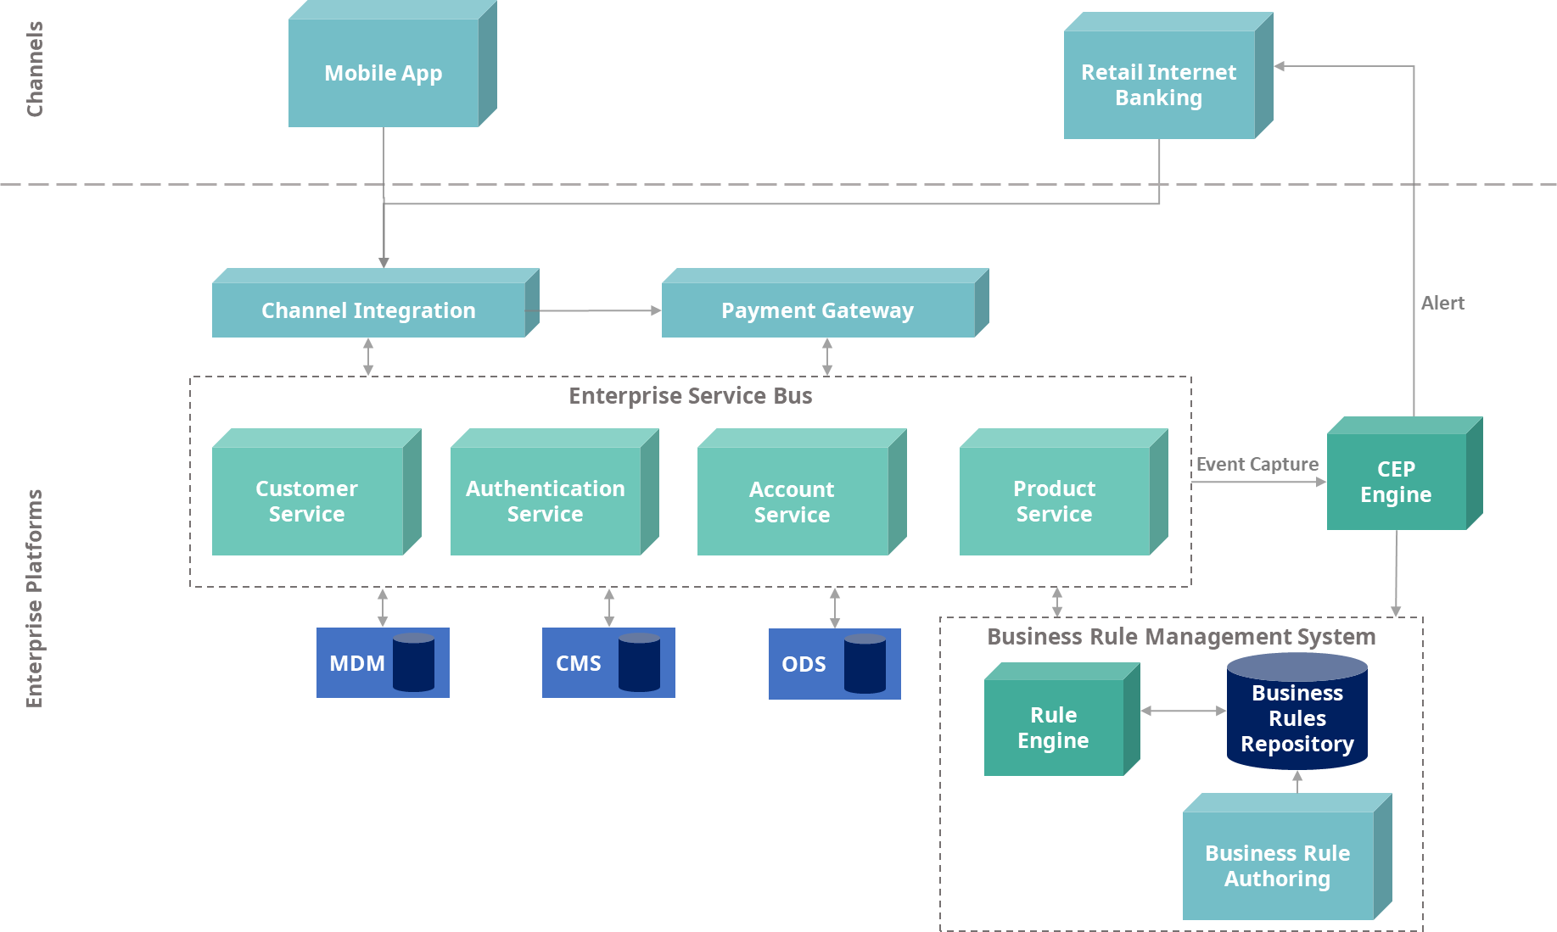
Software Architecture Diagram
New*
New*

Slide 6
Complex Event Processing (CEP)
Complex-event processing (CEP) is a kind of computing in which incoming data about events is distilled into more useful, higher level “complex” event data that provides insight into what is happening.
At the core of CEP is a rules engine capable of composing context-sensitive rules, which encompass;
Historical customer banking behaviour and credit worthiness.
Elapsed time between related events.
Proximity or location of events.
Algorithmic measurement or aggregation of numeric event data.

Slide 7


How It Works
Real-time
Events
Event-based
Decisions
CEP: Complex
Event Processing
Decision/
Business Rule
Results
Recommendation
Batch Offer
Upload
Customer
Master Data +
Behavioral Scores

Slide 8


Sustainability of Business Model
Traditional Banks
Unrivalled to traditional banks due to its underlying technologies powering the real-time capabilities
Flexible to change delivering services to customers quicker than traditional banks
Taking over bank’s position as a service provider gaining ownership in customer relationship
Fintech Startups
Unmatched with startups who lacks in enterprise platforms and other capabilities

Slide 9



Implementation & Scalability
Easily implemented by leveraging on Razer Fintech’s current Microservice architecture
Scalable as each Enterprise Platforms and services are maintained independently
Scale according to exposed APIs from the Open API marketplace
Robust functionality capable of accommodating to different Razer Fintech products

